Slide 1
Illinois Farmers as Nutrient Stewards: Opportunities via the Illinois Nutrient Loss Reduction Strategy
IFB Commodities Conference
July 30, 2014
Lauren Lurkins
Director of Natural and Environmental Resources

Slide 2
Why is the Strategy Needed?
Gulf Hypoxia Task Force
  5 federal agencies, 12 states and tribes in the Mississippi River Basin
  Established in 1997 to reduce/control hypoxia in the Gulf
  2008 Action Plan Goals:
    Reduce Hypoxic Zone to 1,930 square miles
    Reduce Nutrient Loading to the Gulf – 45% Total P and Total N

Slide 3
Why is the Strategy Needed?
USEPA Guidance Memo in March 2011
  Purpose: Encourage states to develop nutrient reduction strategies while continuing to develop numeric nutrient standards.
  Lays out 8 elements of a framework

Slide 4
Stakeholder Involvement
Stakeholders met August 2013 – May 2014:
  Illinois Department of Agriculture, Illinois EPA
  University of Illinois Science Team
  Illinois Farm Bureau, Illinois Pork Producers Association, Illinois Fertilizer and Chemical Association, Illinois Corn Growers Association, Illinois CBMP
  Association of Illinois Soil and Water Conservation Districts
  University of Illinois Extension
  NRCS
  Sanitary Districts/Wastewater Treatment Plants
  Prairie Rivers Network, Environmental Law and Policy Center, Sierra Club
  Illinois Environmental Regulatory Group

Slide 5
Status of the Strategy
Illinois EPA plans to release draft for public comment at the end of August
Final strategy will go to USEPA by end of 2014

Slide 6
Science Assessment
February 2013 – Illinois EPA partnered with University of Illinois to develop the Science Assessment:
  Current conditions in Illinois of nutrient sources and export by rivers in the state from point and non-point sources
  Methods that could be used to reduce these losses and estimates of their effectiveness throughout Illinois
  Estimates of the costs of statewide and watershed level application of these methods to reduce nutrient losses to meet TMDL and Gulf of Mexico goals

Slide 7
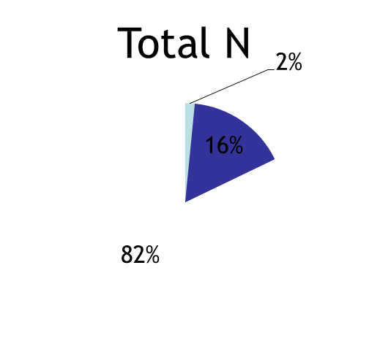
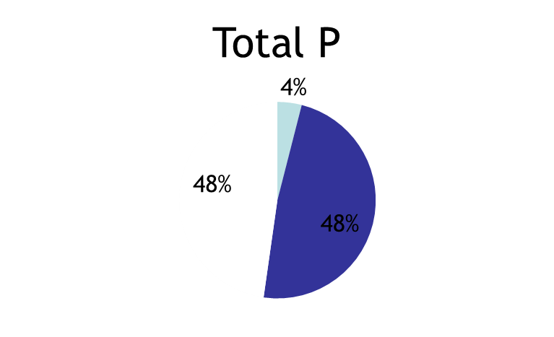
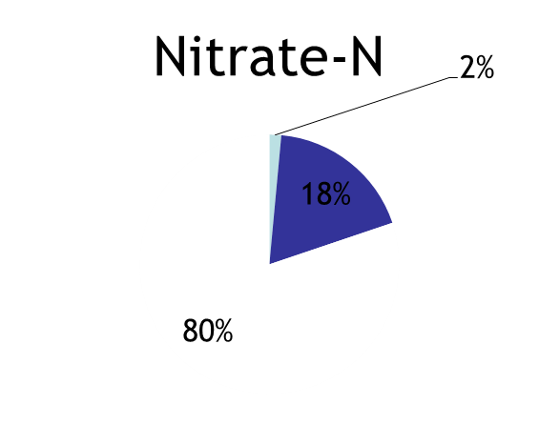
Science Assessment
Illinois contributes 20% of nitrate (410 M lbs) and 11% of phosphorus (37.5 M lbs) that makes it to the Gulf

Slide 8
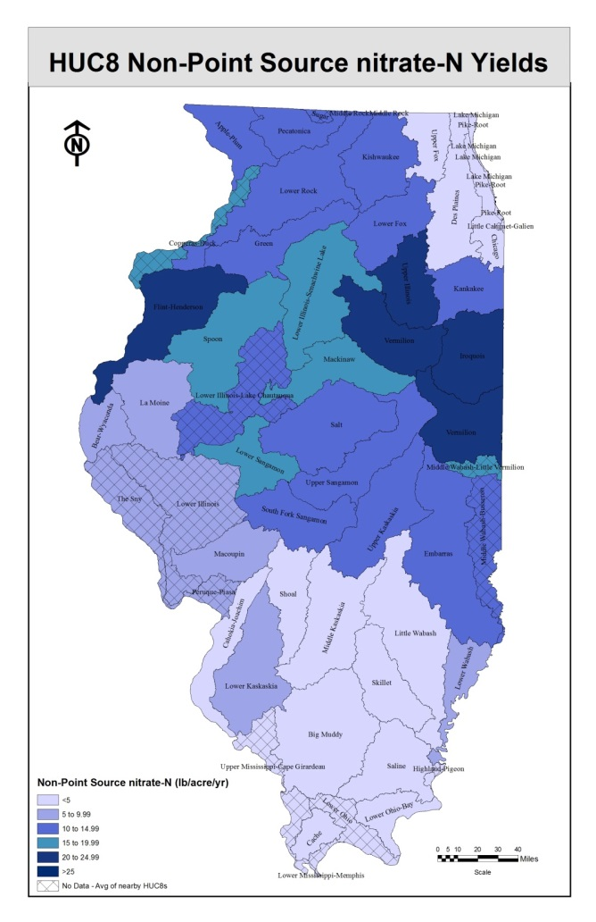
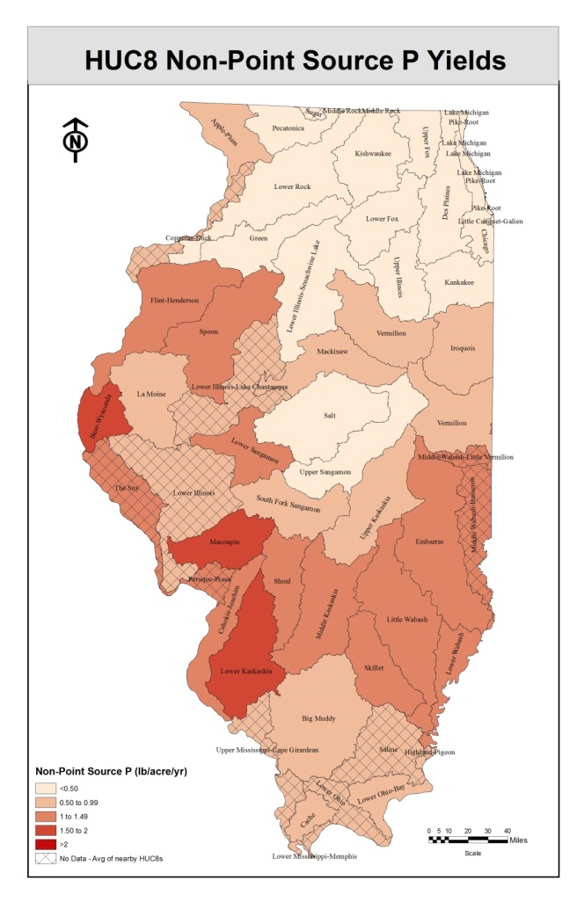

Slide 9
Strategy Targets and Costs
Baseline – Average annual loading of nitrate-N and P from the 1980-1996 levels
Targets – (5 year running average)
  N: 15% by 2025, 45% ultimate
  P: 25% by 2025, 45% ultimate
Estimated costs - $800 million annually from point source and nonpoint source, with no new funding sources

Slide 10
Agricultural Nonpoint Sources
Includes recommended BMPs shown through peer reviewed research to reduce nutrient losses
  In-field (split application of N, cover crops, reduced tillage)
  Edge of field (bioreactors, wetlands)
  Land use changes (perennial crops)
Information on costs and estimated reductions/acre for N and P
Combination scenarios of BMPs to see large scale reductions

Slide 11
Agricultural Nonpoint Sources
Livestock operations - BMPs included for:
  Land application of manure
  Runoff management from production areas

Slide 12
Key Nutrient Reduction Programs for Nonpoint Sources
Focus on building upon existing programs and resources
Reinvigoration of voluntary conservation adoption and nutrient management
No new legislation or regulation

Slide 13
Key Nutrient Reduction Programs for Nonpoint Sources
State Programs
  IEPA
    Section 319 grant program
    Illinois Green Infrastructure Grant
  IDNR
    Conservation Reserve Enhancement Program
  IDOA
    Partners for Conservation Cost-Share (allocated annually to SWCDs)

Slide 14
Key Nutrient Reduction Programs for Nonpoint Sources
Federal Programs
  NRCS
    Environmental Quality Incentives Program
    Conservation Stewardship Program
    Easement Programs (Agricultural Conservation Easement Program and Healthy Forests Reserve Program)

Slide 15
Key Nutrient Reduction Programs for Nonpoint Sources
Illinois Agriculture Initiatives
  Nutrient Research and Education Council
  Council on Best Management Practices
    Keep it for the Crop Education and Outreach Program
    Cover Crop Training Initiative
    Lake Springfield Watershed Project

Slide 16
NREC
Established by Illinois agriculture in 2012 – sustainable funding mechanism for nutrient research and education
Assessment of 75 cents per ton of bulk fertilizer sold in the state. Primarily paid by farmers.
Support projects and programs that address the role of nutrients in enhancing Illinois crop production while minimizing environmental impact

Slide 17
NREC
Annual funding to NREC between $2-2.5 million
2014 is second year of funding
Breakout session today to hear more about specific projects currently funded

Slide 18
Illinois Council on Best Management Practices
Coalition of agricultural organizations and agribusinesses:
  Illinois Farm Bureau, Illinois Corn Growers Association, Illinois Soybean Association, Illinois Pork Producers Association, Illinois Fertilizer and Chemical Association, Syngenta, GROWMARK and Monsanto
Mission is to assist and encourage adoption of BMPs to protect and enhance natural resources and the sustainability of agriculture in Illinois

Slide 19
CBMP Goals
Information: Gather current and accurate information on effective/economically viable BMPs and programs
Awareness: Increase awareness of water quality issues and BMPs that address
Participation: Increase farmer participation in programs and adoption of BMPs
Demonstration: Demonstrate loss reductions and progress on strategy goals

Slide 20
KIC Education and Outreach Program
Overarching program to promote BMPs so farmers aware of variety of tools available
One component – 4R Program
  Nutrient stewardship program to reduce nutrient losses from agriculture, focusing on the 4Rs of Nutrient Use: Right Source, Right Rate, Right Time, Right Place
  Seeks to educate farmers and suppliers to manage nutrients in a systematic approach throughout the growing season, rather than as a single application

Slide 21
KIC Education and Outreach Program
KIC uses the following programs and tools to better educate farmers on the nitrogen cycle, nutrient uptake and optimum nitrogen rates for individual fields:
  On-farm nitrogen rate trials
  N-WATCH soil inventory and tracking program

Slide 22
Cover Crop Training Initiative
Utilize 3 regional cover crop specialists to provide training, education and outreach to promote use of cover crops for nutrient management in production agriculture
Cover crop specialists will:
  Establish demonstration sites
  Work with ag retailers, local SWCDs and IDOA to identify farmers statewide
  Partner with Ag Departments at Community Colleges and establish network for education and outreach throughout the state

Slide 23
Lake Springfield Project
Purpose: To reduce agriculture’s contribution of nitrate-N loading to Lake Springfield
Objective: To help CWLP deliver finished drinking water no less than 5 ppm below the drinking water standard (of 10 ppm)
Length of Program: 3 years

Slide 24
Lake Springfield Project Partners
CBMP
Springfield CWLP
Sangamon County SWCD
Lincoln Land Community College
Farmers
Ag retailers

Slide 25
Lake Springfield Project Components
N-Rate trials
Cover crop sites
N-WATCH locations

Slide 26
Ongoing Strategy Work
The work will continue even after the Strategy is finalized:
  Education and Outreach Committee
  Nutrient Science Advisory Committee (NNCs)
  Water Monitoring Council
Progress will be reviewed and reported to the public every 2 years
Strategy is a living document, will be reviewed every 5 years by the stakeholder group to evaluate necessary revisions

Slide 27
Conclusion
Everyone (urban, suburban, point source, nonpoint source) has contributed to the problem, and now everyone has an opportunity to be part of the solution
Reinvigoration of voluntary conservation adoption and nutrient management on the farm
New focus on tracking implementation of BMPs and resulting water quality impacts
No “one size fits all” approach for all of Illinois agriculture
Our opportunity to demonstrate that voluntary conservation does work!

Slide 28
http://www.epa.state.il.us/water/nutrient/index.html

